Slide 1
Kinetic Energy

Slide 2
By the end of this lesson you should be able to do the following:
Define kinetic energy.
Explain how work and mass influence kinetic energy.
Identify the different types of kinetic energy.

Slide 3

The most familiar type of kinetic energy is the energy used to move things from one point to another.
If you're moving, you are using kinetic energy!

Slide 4

If an object is moving quickly, it has a high kinetic energy (KE). If it is moving slowly, it will have very little kinetic energy.
Kinetic energy is also affected by mass. Heavier objects have more kinetic energy than light objects.

Slide 5
Any type of energy that is based on movement is a type of kinetic energy, and there are many different types!
Examples of kinetic energy are heat, sound, electrical and light.

Slide 6
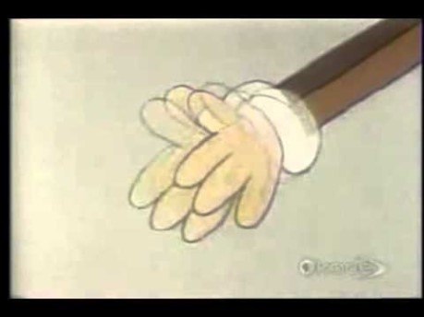

Slide 7
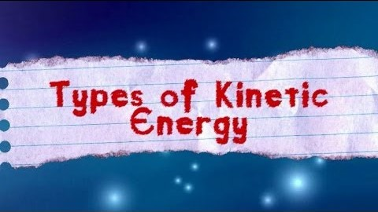

Slide 8
When you turn on a light, it releases light energy. Where does it get the energy to make light energy from?
Electronic components get their energy from electricity! Electricity, or electrical energy, is a form of energy that moves around with the flow of tiny particles called electrons.

Slide 9

Electronic circuits, like the wires in your phone charger, work by letting tiny particles called electrons move along them.
The electrons are moving so they have kinetic energy!

